Slide 1

Lecture 1: Introduction to Machine Learning
Gonzalo De La Torre Parra, Ph.D.
Fall 2021

Slide 2
Overview and Basics
Overview of standard ML techniques using basic mathematical expressions and MATLAB exercises notebooks.
Topics: Introduction to concepts of training, testing, and cross-validation. Linear and nonlinear supervised methods in regression and classification including linear discriminant analysis, logistic regression, nearest neighbor, support vector machines, ridge regression, LASSO, elastic net, and neural networks.
Unsupervised methods including clustering and dimensionality reduction (k-means, GMMs, Hierarchical).
Additional topics depending on time.

Slide 3
Overview and Basics
Mathematics of Machine Learning: Core mathematical ideas used in ML.
Topics: Probability and statistics, vector spaces, linear algebra, convex optimization, gradient and stochastic gradient descent, ML theory (why ML works).
Amount of details to be covered depending on interest.

Slide 4
Overview and Basics
Recent or Advanced Topics: Again, the amount of detail to be covered depends on time.
Topics: Deep learning, self-supervised learning, reinforcement learning, bandit problems.

Slide 5
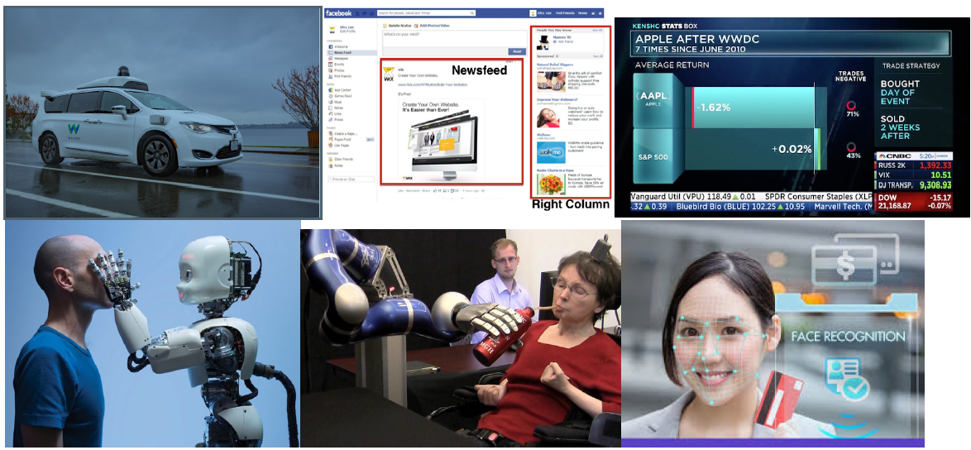
What is Machine Learning?
Definition: Machine Learning (ML) is a collection of ideas (theory, algorithms, computational techniques) from science, engineering, and social sciences that are or can be used to create artificial intelligence.
Applications (source: Google images)
Top (L to R): autonomous vehicles, ad optimization, finance.
Bottom (L to R): robotics, brain-computer interfaces, face recognition.

Slide 6
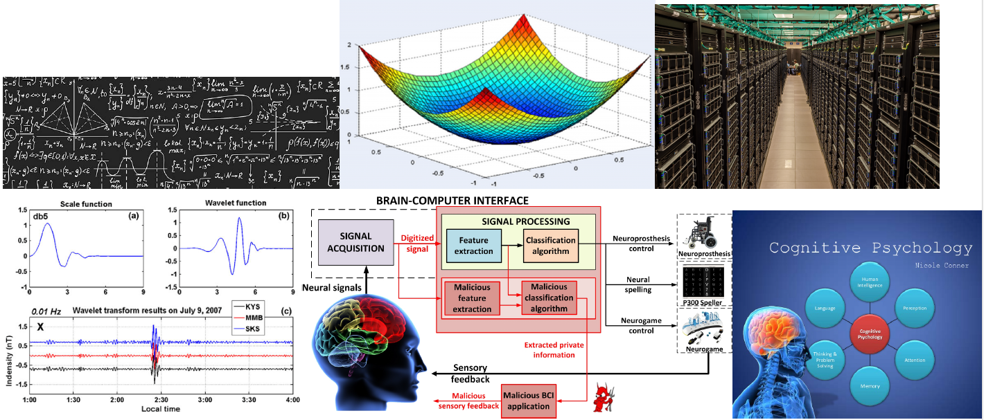
ML is an interdisciplinary subject: Studied in many departments.
Top (L to R): mathematics and statistics, operation research, computer science.
Bottom (L to R): electrical engineering, neuroscience, humanities.
All departments have a legitimate need to study ML.

Slide 7
ML is an interdisciplinary subject: Studied in many departments.
Mathematics, Statistics: Provides foundational ideas and techniques.
Electrical Engineering: Tools from Signal Processing, Control Theory and
Information Theory are very useful.
Operations Research: Study optimization problems and their numerical
solutions.
Computer Science: What can be computed and how eciently.
Medicine: Provides important questions and working solutions.
Humanities: Ideas from Psychology and Sociology helps us to understand how humans think and interact.
Researchers in one discipline may work on topics from other disciplines.

Slide 8
Data and Two Types of ML Problems
The starting point in ML is data. You are given some data and asked to learn something. The way data is given depends on the type of problem.
Supervised ML: Here you are given n pairs of data points:
(x1, y1), (x2; y2), … , (xn, yn)
Problem: x and y have a relationship, you need to discover it.
Datatype: Both x and y could be vectors or matrices.
Examples:
1. Given measurements of some patients (x), predict a quantitative measure of disease (diabetes) progression one year after baseline (y).
2. Given images of hand-written digits, predict the true digits.
3. Given measurements of a flower, predict the type of flower.
4. See the next three slides for samples of such data.

Slide 9
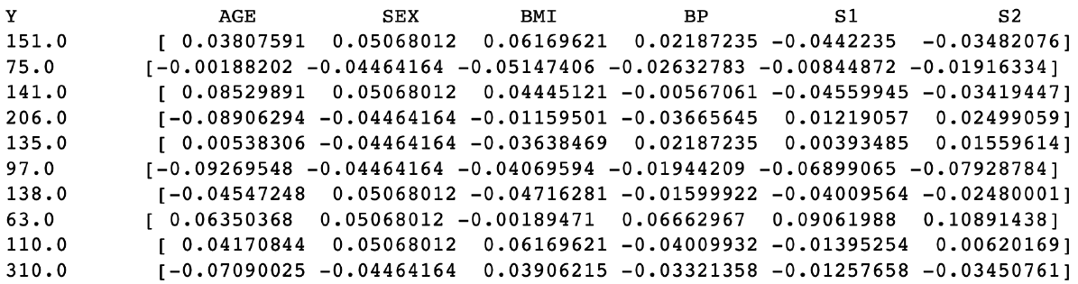
The diabetes data contains data from 442 patients. It has 10 variables. We need to use those 10 variables (I have shown only 6 of them below) to predict a quantitative measure of disease (diabetes) progression one year after baseline.
The data is mean-shifted and normalized. That is why AGE is less than 1 and negative.
Since what we want to predict, i.e., Y , is a real number, this supervised ML problem is called a problem in REGRESSION.

Slide 10
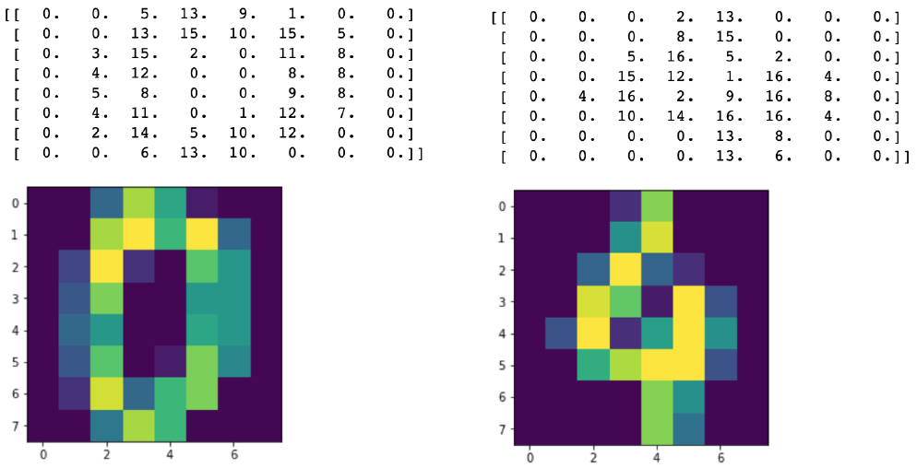
The digits data is made up of 1797 8 8 images. We need to use the images (stored as matrices) to predict the true digit.
The Xs are the 8 x 8 matrices and Ys are the actual true digits: Y = 0 and Y = 4.
Since what we want to predict, i.e., Y , is a discrete-valued quantity or is a label, this supervised ML problem is called CLASSIFICATION.

Slide 11
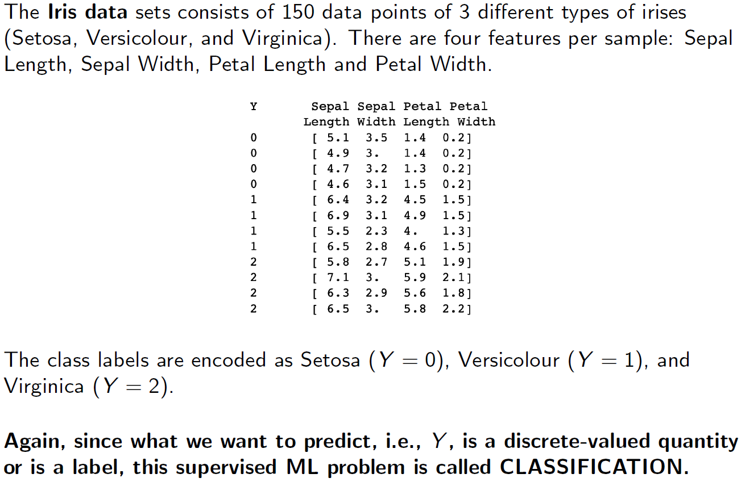

Slide 12
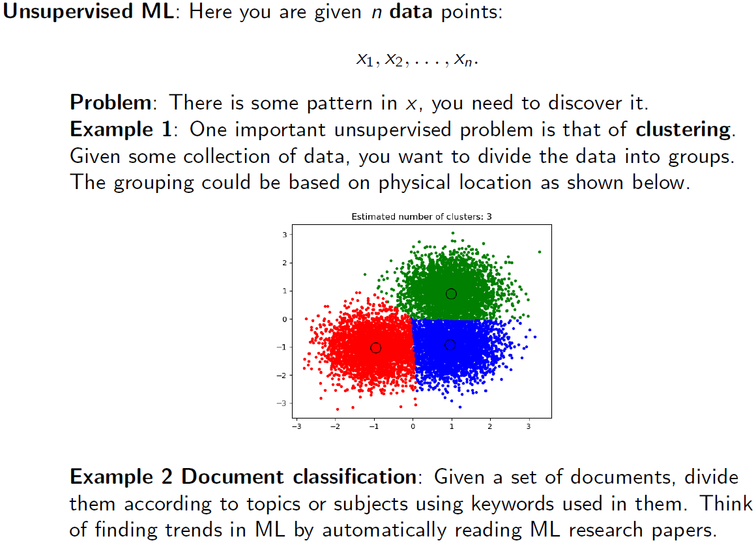

Slide 13
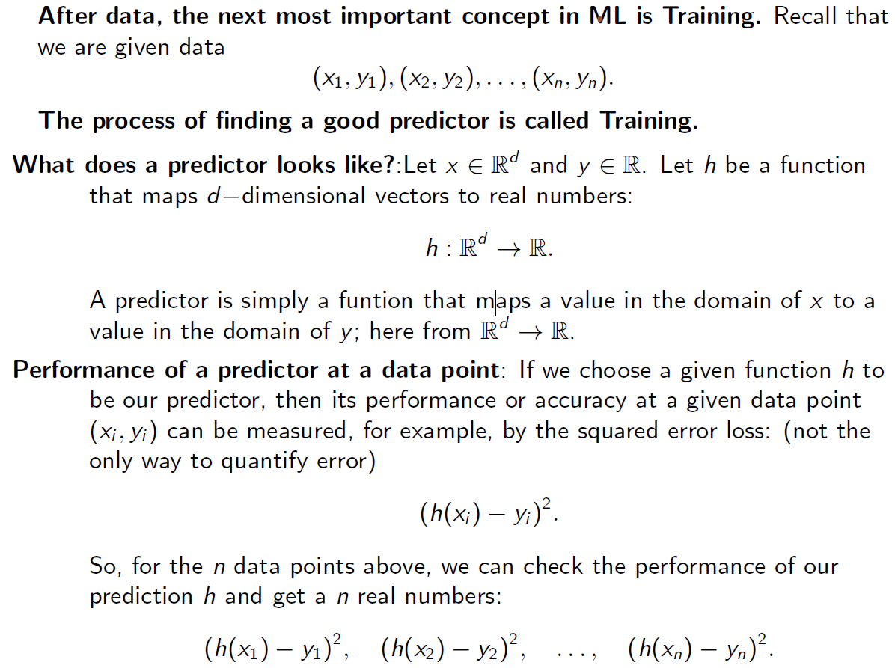
Training for Supervised ML

Slide 14
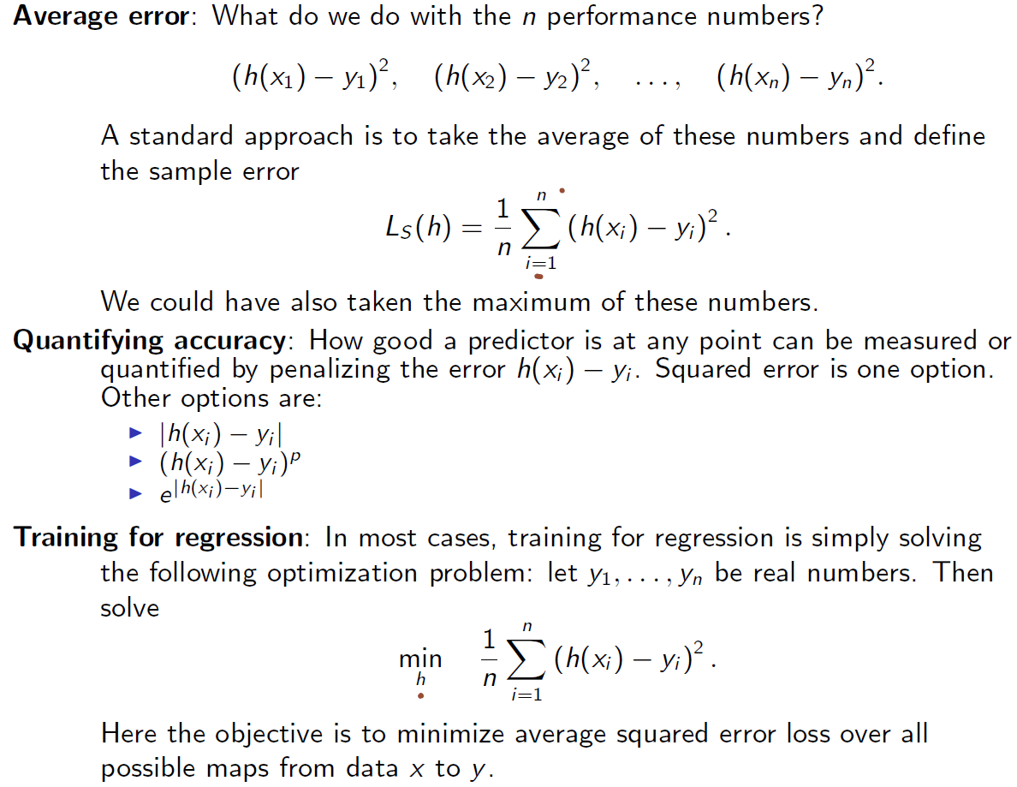

Slide 15
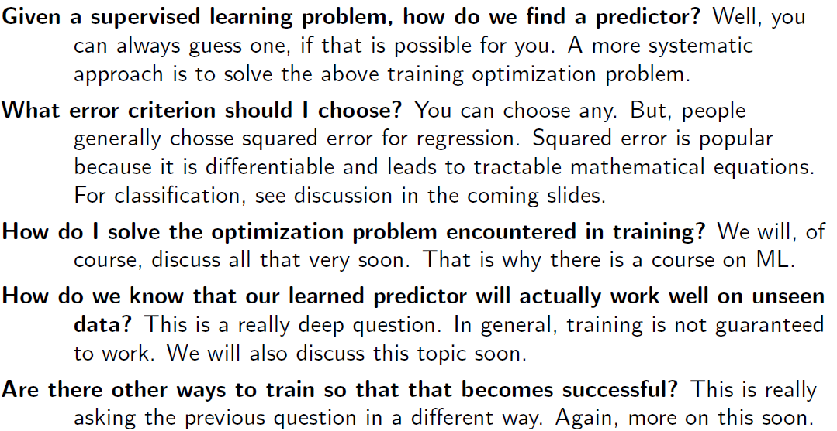
Some fundamental Questions

Slide 16
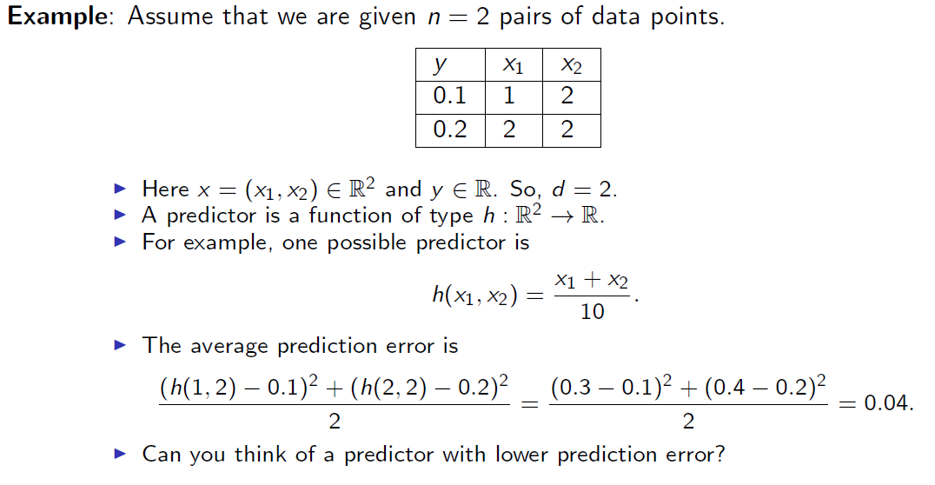

Slide 17
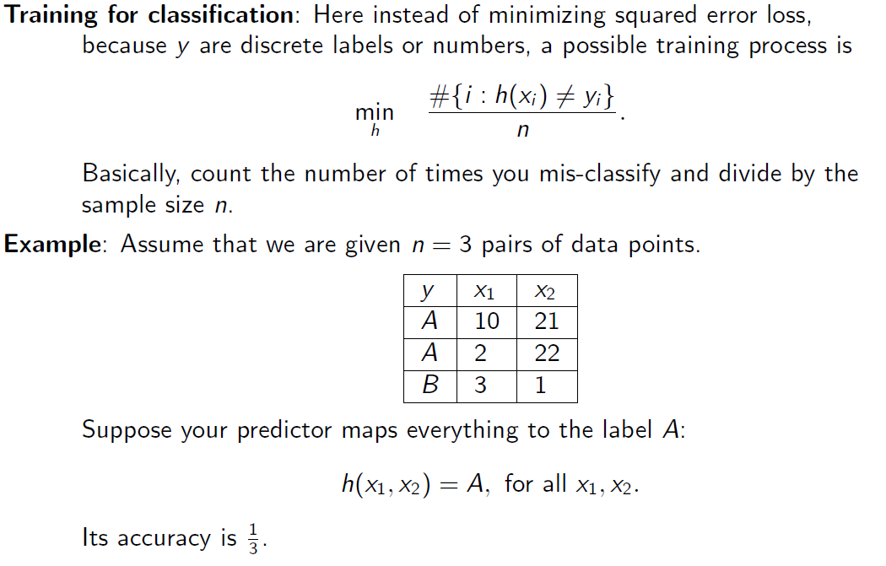

Slide 18
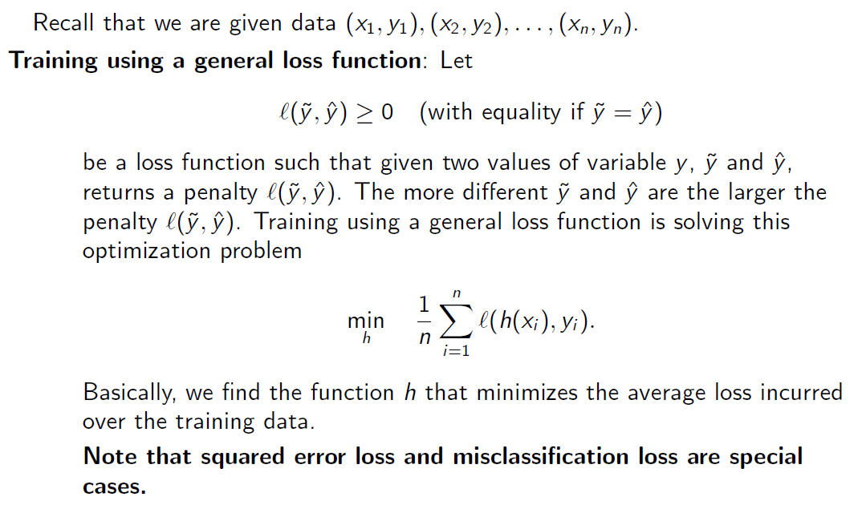

Slide 19
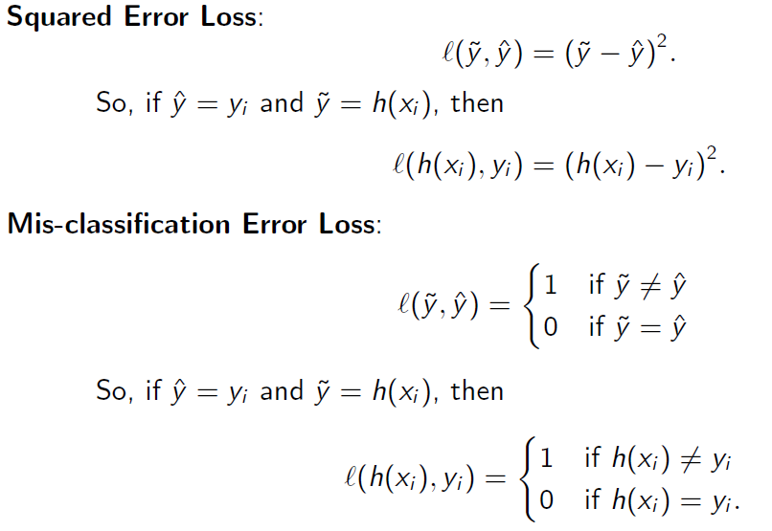

Slide 20
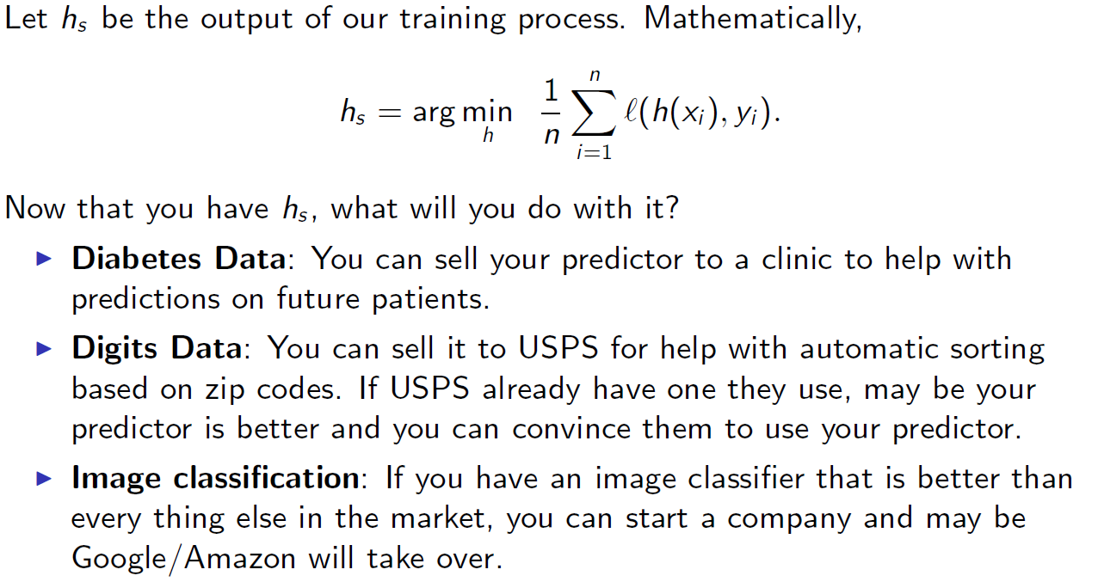
The Output of Training and it's Use

Slide 21
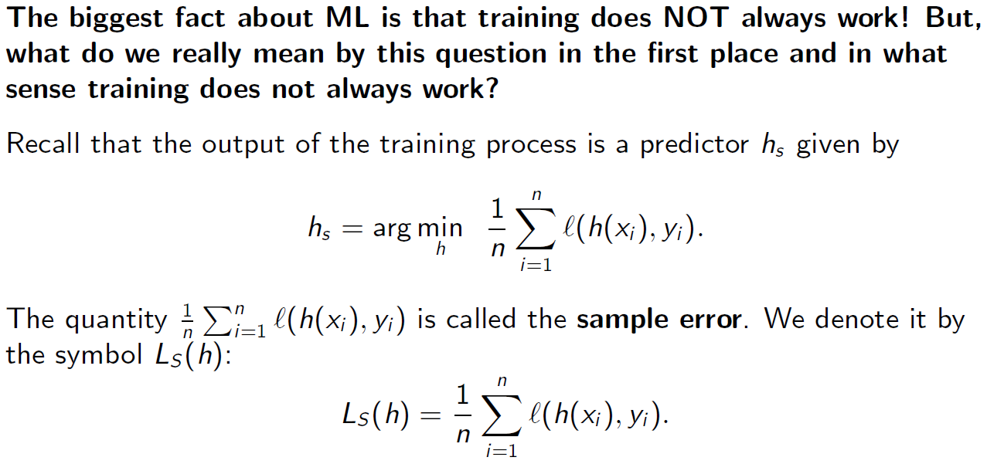
Does Training Work? Types of Errors

Slide 22
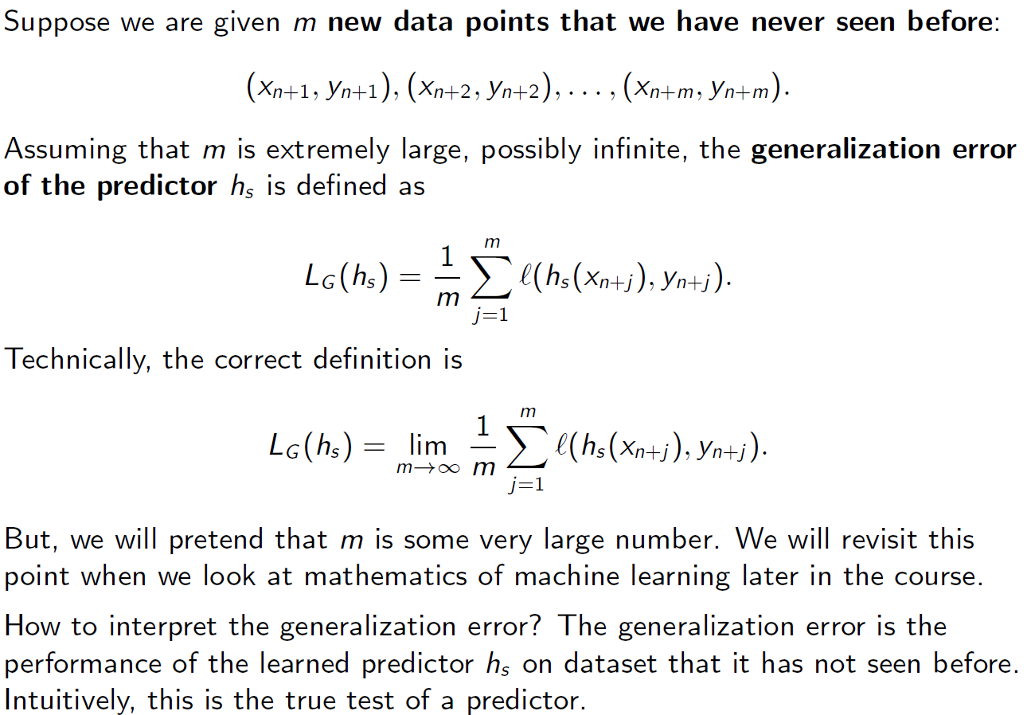

Slide 23
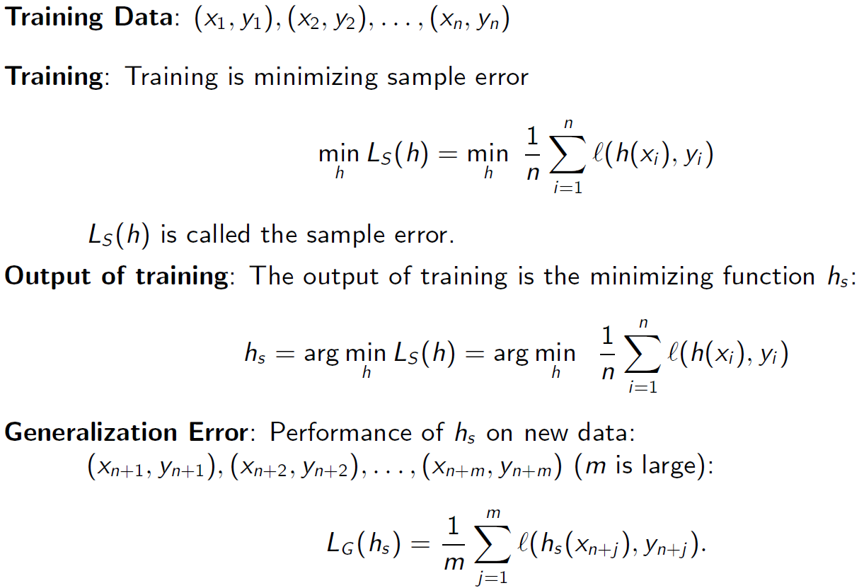
Quick Review of Definitions

Slide 25
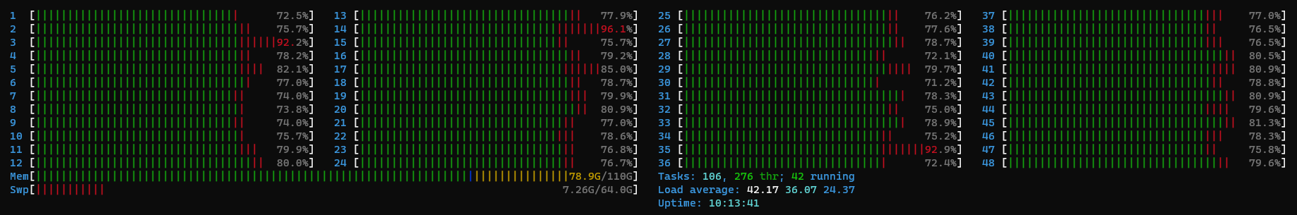
Parallel Processing

Slide 27
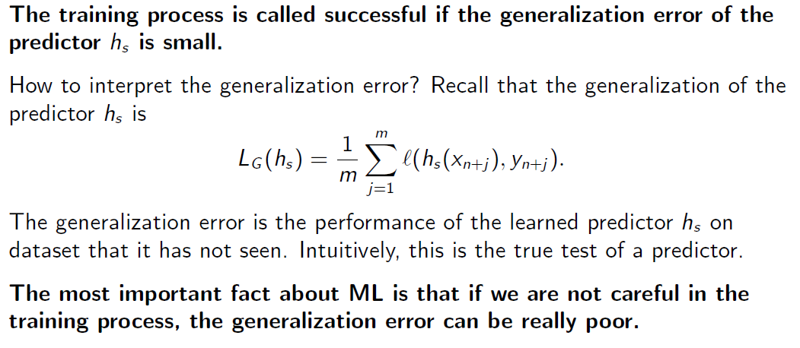
When is the Training Process called Successful?

Slide 28
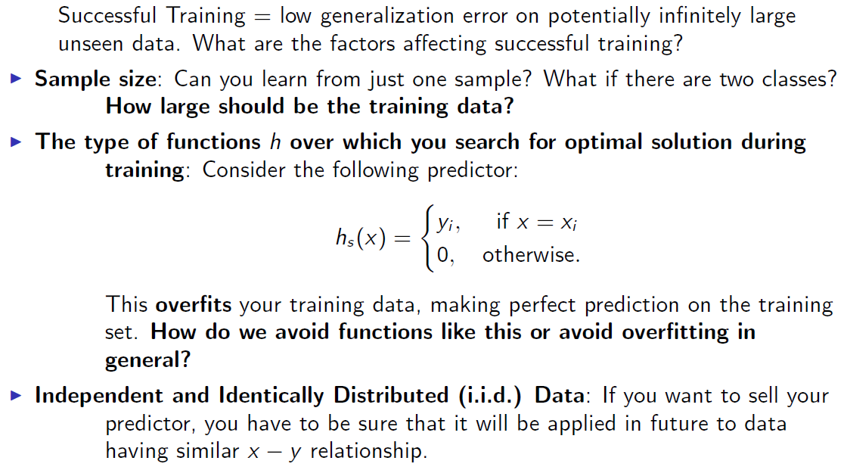
Factors Affecting Successful Training

Slide 29
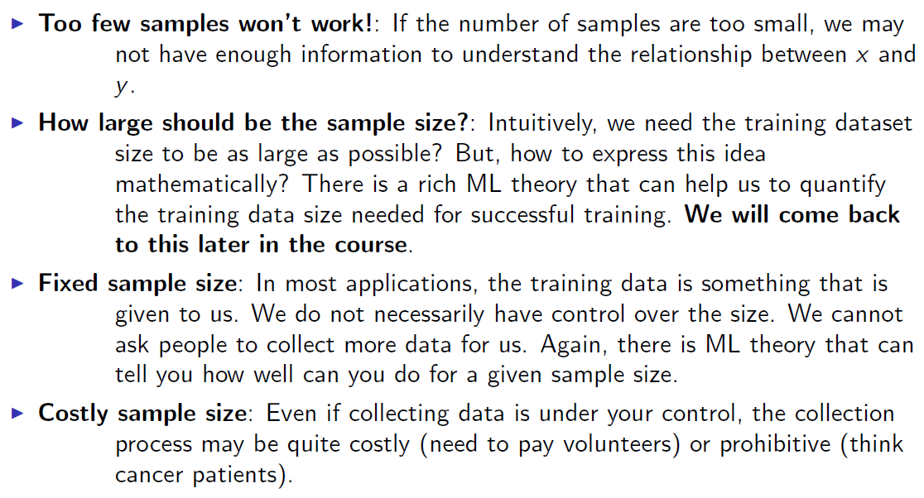
Sample Size

Slide 30
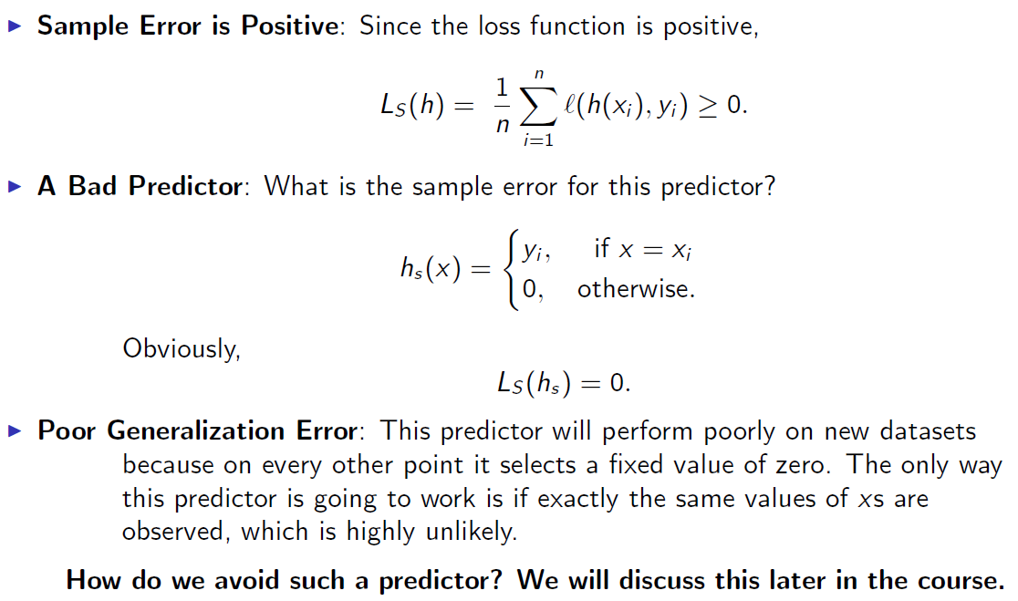
Class of Predictor Over Which we Search

Slide 31
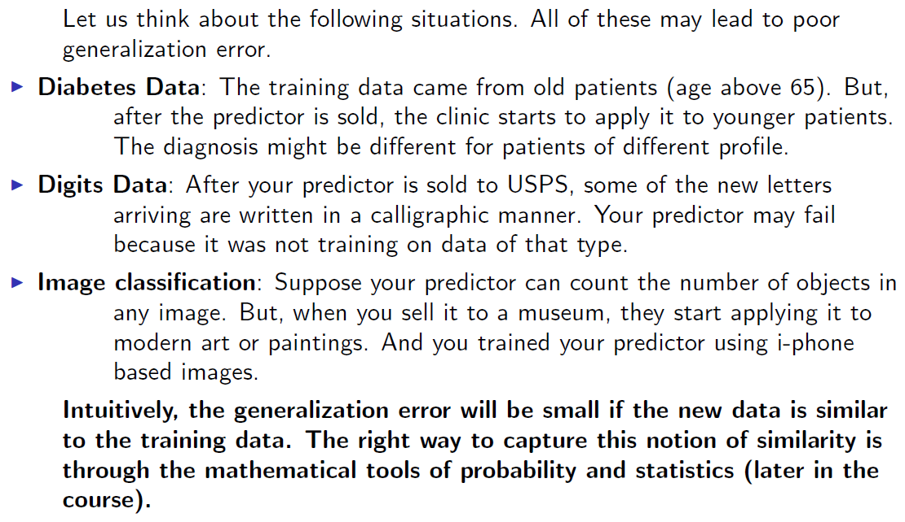
Independent and Identically Distributed Data

